Slide 1

Green Pace
Security Policy Presentation
Developer: Karina Denise Washington

Slide 2

OVERVIEW: DEFENSE IN DEPTH
Green Pace’s security policy is built on the defense-in-depth strategy, which assumes that no single security control is enough to protect a system on its own.
Defense in depth uses multiple layers of security so that if one layer fails, another layer can still protect the system. This approach reduces the risk of a full system compromise and limits the damage caused by attacks.
The layered model includes protection at the physical, network, host, application, and data levels. At Green Pace, this strategy is enforced through secure coding standards, automated testing, encryption, monitoring, and access controls.
By applying security at every stage of development and deployment, Green Pace ensures that vulnerabilities are detected early and mitigated before they can be exploited.

Slide 3
THREATS MATRIX
Green Pace develops software for environmentally responsible entrepreneurs, which means our systems store sensitive business, financial, and user data. As the company grows, so does the attack surface. A single security control is no longer enough to protect against modern cyber threats.
This is why Green Pace adopted a defense-in-depth security strategy. Defense in depth uses multiple, layered security controls so that if one control fails, another layer still protects the system. Security is not treated as a final step—it is embedded into every phase of development and deployment.
Our policy ensures that security is addressed across all layers:
Physical security
Cloud and network security
Host and endpoint security
Application security
Data and asset protection
By combining secure coding standards, automated testing, encryption, access controls, and monitoring, Green Pace reduces the likelihood that a single vulnerability will result in a full system compromise.
Likely High probability, moderate impact Examples: STD-003-CPP (String Correctness) STD-006-CPP (Assertions) STD-009-CPP (Fixed Buffer Input) Why: These issues occur frequently in real code and are commonly introduced by developers. If not detected early, they can lead to crashes or security holes. | Priority High likelihood and high impact Examples: STD-004-CPP (SQL Injection) STD-005-CPP (Memory Protection) STD-008-CPP (Pointer & Bounds Safety) Why: These vulnerabilities can allow attackers to: Execute arbitrary code Access sensitive data Corrupt memory They must be fixed first because they pose the greatest business and security risk.
Low priority Low likelihood, low impact Examples: STD-001-CPP (Data Type Correctness) STD-002-CPP (Data Value Correctness) Why: These usually cause logic errors rather than direct exploitation. While still important, they pose less immediate danger | Unlikely Low likelihood, high impact Examples: STD-010-CPP (Protect Secrets) STD-007-CPP (Exceptions) Why: These occur less often, but when they do, the consequences can be severe—such as credential leaks or hidden system failures.

Slide 4
10 PRINCIPLES
Security Principle | Related Coding Standards
1. Validate Input Data | STD-001-CPP (Data Type), STD-002-CPP (Data Value), STD-003-CPP (String Correctness), STD-008-CPP (Pointer Safety), STD-009-CPP (Secure Buffers)
2. Heed Compiler Warnings | STD-001-CPP (Data Type), STD-006-CPP (Assertions)
3. Architect and Design for Security Policies | STD-004-CPP (SQL Injection), STD-007-CPP (Exceptions), STD-010-CPP (Protect Secrets)
4. Keep It Simple | STD-001-CPP (Data Type), STD-005-CPP (Memory Protection)
5. Default Deny | STD-002-CPP (Data Value), STD-004-CPP (SQL Injection), STD-009-CPP (Secure Buffers)
6. Least Privilege | STD-010-CPP (Protect Secrets)
7. Sanitize Data Sent to Other Systems | STD-004-CPP (SQL Injection), STD-010-CPP (Protect Secrets)
8. Defense in Depth | STD-003-CPP, STD-005-CPP, STD-008-CPP, STD-009-CPP
9. Effective Quality Assurance | STD-003-CPP, STD-006-CPP, STD-007-CPP
10. Adopt a Secure Coding Standard | All Standards: STD-001-CPP through STD-010-CPP

Slide 5
CODING STANDARDS
STD-004-CPP — SQL Injection (parameterized queries)
STD-005-CPP — Memory Protection (RAII/smart pointers)
STD-003-CPP — String Correctness (avoid unsafe C strings)
STD-010-CPP — Protect Secrets / Avoid Sensitive Data Exposure
STD-009-CPP — Secure input into fixed buffers (prevent overflow)
STD-008-CPP — Pointer and bounds safety (range-check element access)
STD-007-CPP — Exceptions (avoid error hiding, handle safely)
STD-002-CPP — Data Value correctness (overflow/underflow checks)
STD-001-CPP — Data Type correctness (safe conversions)
STD-006-CPP — Assertions (invariants only, not security validation)
I ranked standards using a “risk-first” approach: impact + likelihood + ease of exploitation. SQL injection and memory corruption are ranked highest because they can directly lead to unauthorized access, data theft, or full system compromise, especially in a banking-style application. String/buffer issues are also near the top because they frequently appear in real code and can become memory safety vulnerabilities. Secret exposure is ranked high because it increases the blast radius of any incident (credentials and tokens are often “game over”). Lower-ranked items like data type/value correctness are still important, but they tend to be more contextual or edge-case driven. Assertions are ranked last not because they are unimportant, but because the policy is mainly about preventing misuse—assertions must never be treated as production security controls.

Slide 6
ENCRYPTION POLICIES
Encryption at Rest
Protects stored data such as databases and backups using AES-256 encryption. Prevents attackers from reading stolen files.
Encryption in Flight
Protects data as it travels between systems using TLS. Prevents interception and man-in-the-middle attacks.
Encryption in Use
Protects sensitive data in memory using secure enclaves or process isolation. Prevents memory scraping attacks.

Slide 7
TRIPLE-A POLICIES
Authentication
Verifies who the user is. All users must log in using strong credentials and MFA when available.
Authorization
Controls what users can access. Permissions are assigned based on role and least privilege.
Accounting
Tracks all user activity. System logs record logins, data changes, file access, and permission changes for auditing and incident response

Slide 8
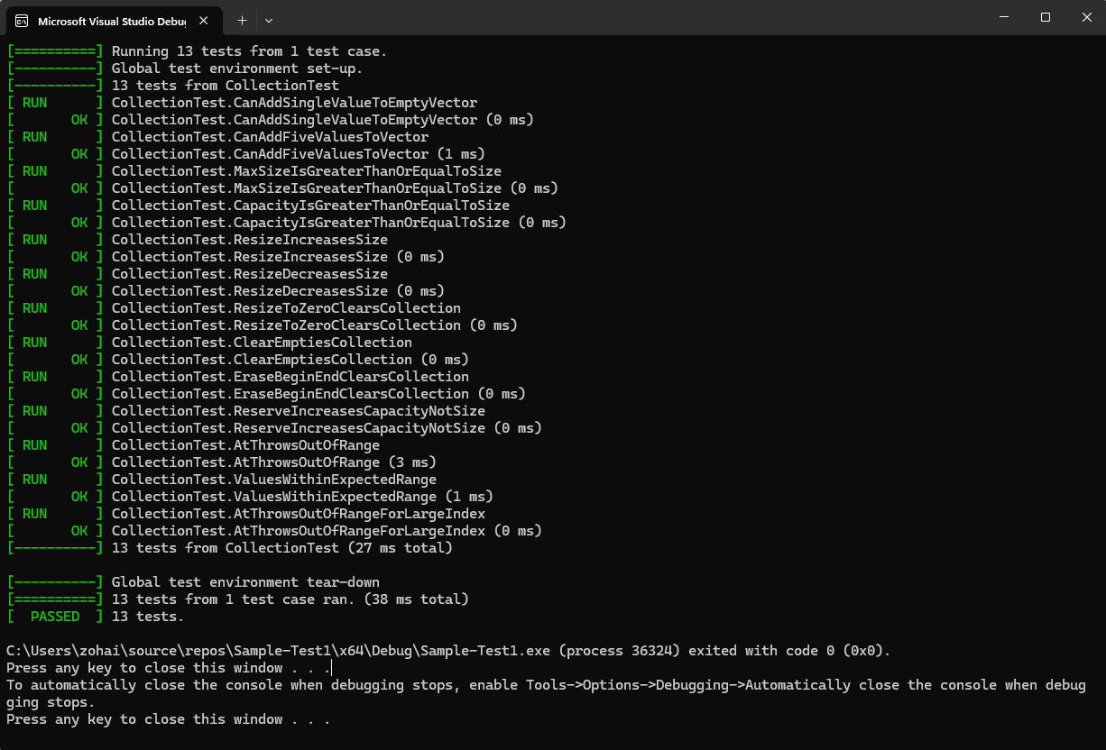
Unit Testing
“Can the vector add one value to an empty collection?”
Purpose: verify basic add behavior
Expected: size becomes 1, not empty
Evidence: screenshot of passing test

Slide 9
Unit Testing
2 “Can the vector add five values correctly?”
Purpose: verify multiple inserts
Expected: size becomes 5
Evidence: screenshot

Slide 10
Unit Testing
3 “Does calling at() out of bounds throw an exception?” (Negative)
Purpose: safe bounds checking
Expected: std::out_of_range thrown
Evidence: screenshot

Slide 11
Unit Testing
4 “Does resizing larger increase size correctly?”
Purpose: resize expands container
Expected: size increases to target
Evidence: screenshot

Slide 12
Unit Testing
5 “Does clear() erase the collection?”
Purpose: confirm erase behavior
Expected: empty + size 0
Evidence: screenshot

Slide 13
Unit Testing
6 “Does reserve() increase capacity without changing size?”
Purpose: prevent logic mistakes
Expected: capacity increases, size unchanged
Evidence: screenshot

Slide 14

AUTOMATION SUMMARY

Slide 15
TOOLS
Pipeline Stage | Tools Used | Purpose
Plan | Threat modeling tools, security training platforms | Identify risks early
Create | IDE security plugins, compiler warnings | Detect unsafe code
Verify | Cppcheck, SonarQube, SAST, DAST, SCA | Find vulnerabilities
Pre-Production | Fuzzing tools, integration tests | Stress-test systems
Release | Code signing tools | Ensure integrity
Prevent | Signature verification, WAF | Block malicious input
Detect | RASP, network monitoring, UEBA | Monitor for attacks
Respond | SOAR tools, WAF rules | Automated response
Predict | Vulnerability analytics | Identify trends
Adapt | Security audits, policy updates | Improve defenses

Slide 16
TOOLS
Explanation of DevSecOps Pipeline:
Green Pace follows a DevSecOps pipeline where security isembedded into every stage of the software development lifecycleinstead of being added at the end. This approach ensures thatvulnerabilities are detected early, fixed quickly, and continuouslymonitored after deployment. Security is treated as a shared responsibility between development, operations, and securityteams.
The pipeline begins during the Plan phase, where threatmodeling, security training, and technical security debt areaddressed. During the Create phase, developers use IDEsecurity plugins that provide real-time feedback on unsafe code.In the Verify phase, automated security scans such as staticanalysis (SAST), dynamic testing (DAST), and softwarecomposition analysis (SCA) are run to detect vulnerabilitiesbefore the code is merged.
In Pre-Production, advanced testing such as fuzzing, chaostesting, and integration testing is used to simulate real-worldattacks. During the Release phase, software is digitally signed toensure integrity. Once deployed, the Prevent and Detect stagescontinuously protect the application using integrity checks,runtime monitoring, intrusion detection, and behavior analysistools. If a threat is discovered, the Respond stage automaticallytriggers protective actions, and the Predict and Adapt stagesanalyze trends to prevent future attacks.

Slide 17
RISKS AND BENEFITS
Problems:
Legacy code, human error, delayed security testing.
Solutions:
Automated testing, secure standards, continuous monitoring.
Risks of Waiting:
Data breaches, regulatory fines, system compromise.
Benefits of Acting Now:
Reduced attack surface, faster detection, stronger trust.
Next Steps:
Expand automation, continuous audits, regular training.

Slide 18
RECOMMENDATIONS
Security Gaps:
No continuous penetration testing
Limited developer security training
No real-time threat intelligence integration
Recommendations:
Add continuous fuzz testing
Enforce mandatory security code reviews
Integrate SIEM and threat intelligence feeds
Expand unit and integration security testing

Slide 19
CONCLUSIONS
Standards to Adopt to Prevent Future Problems
To prevent future security vulnerabilities, Green Pace must consistently enforce secure coding and architectural standards across all teams. Adopting the SEI CERT C++ Coding Standard as a mandatory baseline will reduce common risks such as buffer overflows, unsafe type conversions, and memory errors.
Security should be automated by default. Tools like Cppcheck, SonarQube, and compiler warnings treated as errors must run in every build so vulnerabilities are caught early, when fixes are faster and less costly.
Green Pace should also standardize encryption in flight, at rest, and in use with approved cryptographic libraries. This ensures sensitive data remains protected even if other defenses fail.
Finally, strengthening the Triple-A framework—authentication, authorization, and accounting—will improve access control, accountability, and incident response.
Together, these standards support a strong defense-in-depth strategy and help Green Pace move from reacting to threats to preventing them.

Slide 20
REFERENCES
CMU Software Engineering Institute. (2023). SEI CERT C++ coding standard.
https://wiki.sei.cmu.edu/confluence/display/cplusplus
OWASP Foundation. (2023). OWASP top 10: The ten most critical web application security risks.
https://owasp.org/www-project-top-ten/
SonarSource. (2024). SonarQube: Continuous code quality and security.
https://www.sonarsource.com/products/sonarqube/
Cppcheck. (2024). Cppcheck: A static analysis tool for C/C++ code.
https://cppcheck.sourceforge.io/
Van Niekerk, S. (2019). Defense in depth: A layered security strategy [Illustration]. Peerlyst.
https://www.peerlyst.com/posts/nhs-healthcare-defense-in-depth-shaun-van-niekerk
NIST. (2023). Digital identity guidelines (SP 800-63).
https://pages.nist.gov/800-63-3/
Microsoft. (2024). Secure development lifecycle (SDL).
https://www.microsoft.com/en-us/securityengineering/sdl/
Google. (2023). BeyondCorp: A new approach to enterprise security.
https://cloud.google.com/beyondcorp
ISO/IEC. (2022). ISO/IEC 27001: Information security management systems.
https://www.iso.org/isoiec-27001-information-security.html
Open Web Application Security Project (OWASP). (2023). OWASP testing guide.
https://owasp.org/www-project-web-security-testing-guide/

